Slide 1

Software Development Project Java III
420-517-DW Sections 01 & 02

Slide 2

Grading
You must achieve:
Minimum of 60% for exams
Minimum of 60% for labs and assignments
In this course exams are worth 50 marks and labs are worth 50
This means you must achieve:
At least 30/50 for exams
At least 30/50 for assignments
There is a special rule for the course project worth 35 marks
You must achieve 60% of the project grade
At least 21/35

Slide 3
Cheating and plagiarism
Helping a fellow student is OK
Asking a fellow student for access to their code so you can see how they solved a problem is cheating and plagiarism
You and I must be the only people with access to you repo
Allowing your friends access to your repo is cheating and plagiarism

Slide 4
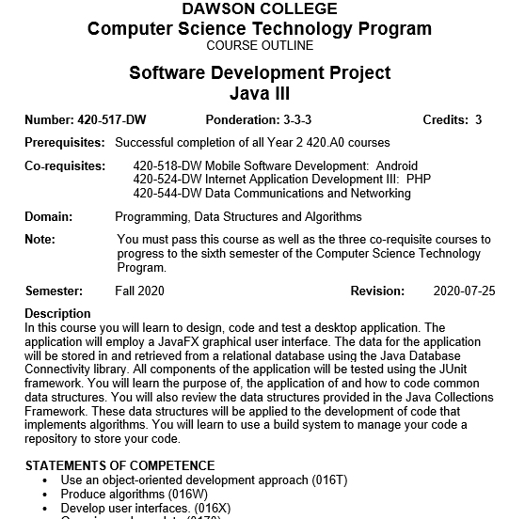
Let’s review the course outline

Slide 5
The textbook: Java by Comparison

Slide 6

Let’s look at the project

